Slide 1
NAO Sprint 2 Review
C1C Christian Arnold
C1C Casey Born
C1C Adrian Chiriac
C1C Katrina Domeyer
C1C Colin Schnoes
C1C Jacob Taylor
Notes:
Casey

Slide 2
Sprint 1 Retrospective Meeting
Need to make better use of Scrum
Gained hours of familiarity with Nao System
Good distribution of Work
Use a combined demo in future
Need better hour tracking

Slide 3
Sprint 2 Backlog Items
As a K-5 Educator, I need the NAO to play fun games with my students where they practice determining which of two numbers is larger so that they will be motivated to develop and practice their number understanding of numeric ordering.
As a K-5 STEM Supporter, I need the NAO to engage with my students in activities and demos that would encourage their interests in STEM studies and careers so that they will be excited, motivated, and not intimidated to further their studies in STEM subjects to include computer science and robotics.
As a STEM Supporter, I need the NAO to play the High-Low game with students in an age-appropriate conversational manner (K-5, 6-8, 9-12) to help develop number understanding and algorithmic reasoning skills (bisection searching) so that the students are motivated for further studies of computer science.
As a STEM Supporter, I need the NAO to play the Rock-Paper-Scissors game with students in an age-appropriate conversational manner (K-5, 6-8, 9-12) so that the students are motivated for further studies of computer science.

Slide 4
Sprint 2 Backlog Items (Cont.)
As a Developer for the NAO, I need the NAO to perform animated emotional responses (with or without speaking) to indicate surprise, thinking/pondering, happy, sad, excited, 'whatever' attitude, 'What'z up?', and other similar emotions.
As a Special Needs K-5 Educator, I need the NAO to say (in an animated manner), "Uh, I am upset right now. May I have a break, please" so that the student will understand that it is okay to feel upset and ask for a break.
As a Computer Scientist, I need the NAO to demonstrate Isaac Asimov's Three Laws of Robtics (No Harming Humans, Do What They Are Told, Self-Preservation - where each is trumped by the previous) so that we can demonstrate the laws to others and explore how such a hierarchy of priorities might be implemented.
As a STEM Outreach Educator, I need the NAO to have a repository of Choregraphe modules that can be used by K-5 students to program the NAOs to tell stories of their creation so that I can teach the students some basic programming skills to include sequential, conditional, and iterative logic, concurrency and synchronization, and data storage and retrieval.

Slide 5
Sprint 2 Tasks
Finish Rock-Paper-Scissors
Fix Choices (2 hr)
Add extra animations (4 hr)
Beta Testing (2 hr)
Fix access to code repository (30 min)
Sprint Review Prep
Demo (2 hr)
Presentation (2 hr)
Admin Framework (3 hr)
Notes:
Adrian

Slide 6
Sprint 2 Tasks (Cont.)
Finish High-Low
Code Exploration (6 hr)
Beta Testing (2 hr)
Attitude Dialog (2 hr)
Alter Star Wars Demo
Do not sit down at end (1 hr)
Explore Capabilities
Range Finding (5 hr)
Facial Recognition (5 hr)
Support Asimov’s 3 Laws (5 hr)

Slide 7
Sprint 2 Tasks (Cont.)
K-5 Emotions Demo
“I’m tired, I need a break”
“I’m confused”
Perform in an animated manner (6 hr)
Add additional responses (4 hr)
Happy
Sad
Excited
“Whatever” (Indifference)

Slide 8
Design Model
System architecture
Choregraphe
Nao Robot
Notes:
Katie

Slide 9
Risks
Risks | Likelihood | Impact | Mitigation
Robot Health | High | No testing platform | Continue to send in robots for repairs
Old Source Code | Moderate | “Re-inventing the Wheel” | Contacting old capstone groups, use public repository
Compacted Schedule | Moderate | Low work-efficiency | Better time management, Personal Hour Tracker

Slide 10
Test Plan
Testing is performed incrementally anytime code is physically run on the robot
Verifying animations and flow of program
Finding random people to test robot functionality (Beta testing)
Notes:
First bullet – Christian talk about your testing process
Second bullet – Colin and Jacob talk about your stability testing process

Slide 11
Hour Tracking

Slide 12
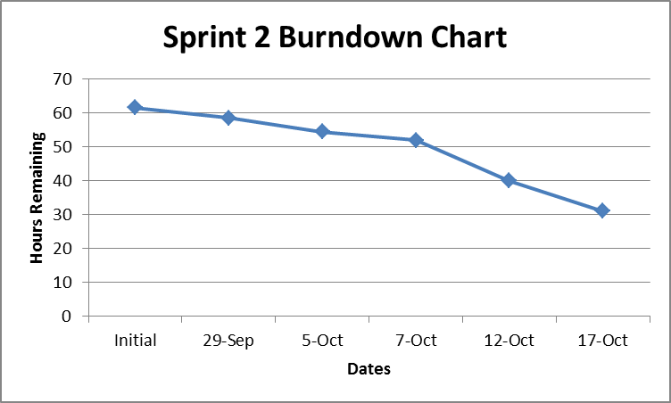
Sprint Burndown Chart

Slide 13
Demo

Slide 14
Anticipated Goals for Next Sprint
Continue Exploring Capabilities
K-5 Emotions Demo
Continue working on enhancing Rock-Paper-Scissors game with visual recognition
Fix the High-Low game.
Start work on the number recognition game.
Notes:
Katie

Slide 15
Summary and Takeaways
Robots are fragile
Sprint schedule was very compacted
Improve Work Efficiency
Based on 3 hours per lesson, 81% Efficiency
More Even Workload
Improve Communication from some people…
Notes:
Katie

Slide 16
Documentation
None.

Slide 17
Questions?

